Slide 1
Use of Blogs, RSS , WIKIS, Podcast, microblogging

Slide 2


Slide 3
Blogging
Is a journal of ideas or a diary published online. Its owner has the freedom to express his opinions about one or more topics.
A blogging site is one that provides a personal online space in which one can write and publish texts, or news items called “posts”, which may also contain images and hyperlinks.
They are designed to be used as online diaries collected chronologically. The “posts” or articles are shown from newest to oldest, where the author always retains the freedom of publishing whatever seems appropriate to him.
The blogger can control user comments, and can also enable his blog to be followed by others, which means that the system will send emails or messages to subscribed users whenever the blog owner posts a new article. The most used blog hosts are www.blogger.com and www.wordpress.com

Slide 4
Effective blogging is an essential part of an overall digital marketing strategy. It drives traffic to your website, generates new leads for your company, helps you nurture those leads, and gives you increased insight into your customer base. Blogging is cost-effective and yields measurable results in terms of positive ROI.
Blogging also helps you develop your detective skills in two important ways. First, coming up with topics for a regular blog makes you have to think like your target audience thinks. When writing a good business blog, you are constantly asking yourself what the reader wants to know, how to best impart that knowledge, and how to move the reader to take action. Secondly, capturing analytics for your blog reveals much about the way your web visitors think and feel. Blog analytics allow you to figure out what topics are most popular among your readers, which content they share on social media, and even what time of day they read your content. The more you know about your leads, the more empowered you are to nurture them and get them all the way through the sales funnel.

Slide 5
Guidelines to write a blog!
Post should be 1000-2500 words long.( fewer words will fall short of google algorithm and reduce chances to appear on first page searches
Includes atleast 1- 2 images
Ask open ended questions in the end ( increase engagement)
Pack a Punch: Bullet pointers, list and headers
Keep conversational tone
Avoid industry jargons
Be consistent, strong content, gain momentum post regularly.
Adding relevant tags and keywords for optimizing your search

Slide 6
Micro-blog
Micro-blogging, also known as nano-blogging, is a service that enables its users to send and publish short messages (about 280 characters), usually only text and regularly respond to questions like “What are you doing?” “What do you find interesting?” etc.
These updates are displayed on the user’s profile page and are also immediately sent to other users who have chosen the option of receiving them. The user can restrict the sending of these messages only to members of his circle of friends, or allow its access to all users which is the default setting. An example of micro-blogging site is Twitter.com.

Slide 7


Slide 8
Podcasts
Ipod + Broadcasting
Is a form of digital media that consists of an episodic series of audio, video, digital radio, PDF, or ePub files subscribed to and downloaded through web syndication or streamed online to a computer or mobile device.
Method of Distributing multimedia files such as audio and video programs over internet.

Slide 9
Benefits
Allows listeners to time shift+ place shift media consumption
Easy to create and distribute
100 percent efficiency, global audience
Without any hindrance
Less investment: Plan, Produce, Publish , promote
Equipments
Microphone, audio recording software, headphones

Slide 10
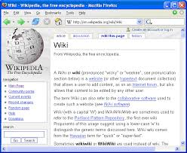

Slide 11
Wiki
A piece of server software that allows users to freely create and edit Web page content using any Web browser. Wiki supports hyperlinks and has a simple text syntax for creating new pages and crosslinks between internal pages on the fly.
Wiki is unusual among group communication mechanisms in that it allows the organization of contributions to be edited in addition to the content itself.
Like many simple concepts, "open editing" has some profound and subtle effects on Wiki usage. Allowing everyday users to create and edit any page in a Web site is exciting in that it encourages democratic use of the Web and promotes content composition by nontechnical users.

Slide 12
Community building
FAQ pages: as brand grows, customer base grows , create wiki pages
Intranet: set wiki pages within departments
Multiple authors
Links to others wiki pages
Constantly changing content

Slide 13


Slide 14
What Is RSS feed?
RSS referred to as Really Simple Syndication.
Allows users to receive regular updates from a website and blog.
It helps the firm to circumnavigate the issues it faces while reaching customers through emails etc.
It brings loyal and repeat visitors to your site driving.
It is a format used to publish content that is regularly published like a blog or news headlines.
It’s a standard format, which means that every RSS feed is designed to look basically the same for consistency.
This typically includes a post title, teaser or full body text, plus the date published and author. RSS feeds will display the most recent entries first, though the number of total entries will vary.

Slide 15
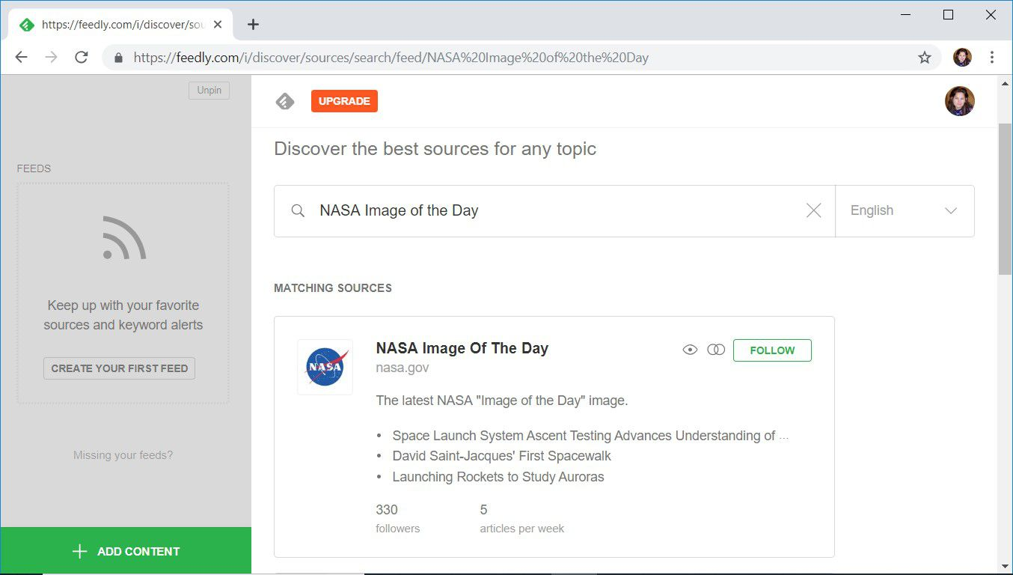

Slide 16
How is RSS Used?
RSS usage begins with a company or news site deciding to publish their new content via RSS. Content Management Systems like Drupal typically provide at least one site wide RSS feed by default. The most common example is to provide an RSS feed of your business blog.
Visitors to your site who are interested in automatically receiving your new blog posts delivered to them will subscribe to your feed. This is generally accomplished by clicking on the RSS feed icon that your webmaster sets up for you and then plugging the address into their RSS Reader. Many email clients and web browsers include RSS readers, or users may choose to use systems like Feed Burner or Google Reader.
Any website publishing new content can offer an RSS feed, but the most typical categories are Business, News and Entertainment.
Interestingly, there have been several times over the last few years where those in the blogosphere have tried to claim that RSS is dead. In fact, like most technical aspects of the Internet, RSS is simply becoming more integrated in the tools that we use and less visible. For example, instead of explicitly subscribing to an RSS feed, you might download a mobile app from a business or news source which is essentially just an RSS feed from their website in a nice mobile format.
The bottom line is that an RSS feed will help you promote the new content that you’re posting to your website or blog and should be an integral component of your Internet marketing mechanisms.

Slide 17
social media dashboard
social media dashboard makes social media management super-easy. It syncs all your social media accounts in one convenient place.
A dashboard also allows you to see all your social media analytics at one place, thus eliminating the need to manually go into each account and check what happened in the past week.
A robust dashboard will let you connect with all major social media platforms out there. Most good tools will sync Facebook, Twitter, Google + and LinkedIn.

Slide 18
Benefits of using a social media dashboard
Productivity (timely posting)
Tracking ( Competitors)
Scheduling ( regular post)
Analytics ( reach , engagement)
Collaboration ( work division)

Slide 19
List of some Social media dashboard
Agorapulse.
DashThis.
SEMrush.
Hootsuite.
Cyfe.
Sprout Social

